Slide 1
Simplex Control and Message/ACK Exchange - Module 6 Final Presentation
Renato Iida: rfiida@wpi.edu
Le Wang: lewang@wpi.edu
Rebecca Cooper: rrcooper@wpi.edu

Slide 2
Outline
Purpose
Proposed Diagram
Implementation
Interfacing
Recorded Demonstration
Lesson Learned

Slide 3
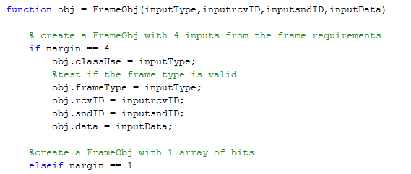
Implementation Constructor
Constructor Method
Verification of number of inputs

Slide 4
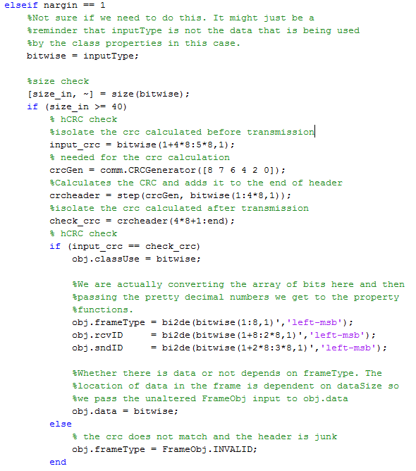
Implementation Constructor
Verify to check if have minimum size
CRC check of header.

